Slide 1
2026 Urgent and Emergency Care Survey
(UEC26)
Trust Webinar 1
Thursday 16th October 2025, 1pm – 2:30pm

Slide 2
Contents
Overview of 2026 Urgent and Emergency Care Survey (UEC26) [15 mins]
Current priorities for UEC26 [30 mins]
Sampling [15 mins]
Questionnaire feedback [10 mins]
Key dates [5 mins]
Engagement [10 mins]
Any other points for discussion? [5 mins]

Slide 3
Overview of 2026 Urgent and Emergency Care Survey (UEC26)

Slide 4
Overview of 2026 Urgent and Emergency Care Survey (UEC26)
  Mixed mode approach
    Mixed mode approach i.e. online survey, paper questionnaires (Type 1, Type 3) with 8 pages, similar in design to UEC24.
    Push to web e.g. inclusion of QR codes and website links on cover letters; SMS texts with survey links.
    Centralised survey offered for NHS Trusts conducting the survey in-house.
    A range of accessibility features offered e.g. BSL, translations, multi-language sheet, screen-reader compatibility.
    Contact approach remains the same as 2024 i.e. a mixture of postal and SMS contact.
Contact Type | Content
Postal – 1st contact | Invitation letter with URL and login details (including QR code) for online survey. Multi-language sheet with QR codes.
SMS – 1st reminder | Reminder sent to complete the online survey (if mobile number is available).
Postal – 2nd reminder | Invitation letter with URL and login details (including QR code) for online survey. Multi-language sheet with QR codes.
SMS – 3rd reminder | Reminder sent to complete the online survey (if mobile number is available).
Postal – 4th reminder | Invitation letter with URL and login details (including QR code) for online survey. Paper questionnaire sent with freepost return envelope. Multi-language sheet with QR codes.
SMS – final reminder | Reminder sent to complete the online survey (if mobile number is available).

Slide 5




Accessibility options
As per previous iteration of the UEC survey, there are a variety of accessibility features available for the online survey and paper questionnaires to ensure all patients can complete the survey in line with their individual needs.
Online survey
A A
Change font size
Change background colour
Screen reader compatible
Multiple language options
British Sign Language
For the paper questionnaire, the following options are available upon request:
  Easy-read
  Large print
  Braille
Patients will also have the option to contact a telephone-assisted helpline to request help to complete the paper questionnaires or the online survey. Help is available in approximately 22 languages.

Slide 6
Urgent and Emergency Care Survey: performance monitoring and evaluation
Trust level data analysis and reporting
Used by individual NHS Trusts to:
  Incorporate patient experience into decision-making.
  Identify areas they are performing well and areas for improvement.
  Monitor progress over time.
The Care Quality Commission (CQC) uses the results to assess NHS performance and for use within inspections
This includes highlighting where there are safety concerns or examples of good care:
CQC’s Assessment Framework

Slide 7
Survey timeline
Stakeholder, patients and frontline staff feedback & questionnaire amends.
Trust draw samples of patients.
Analyse results of survey responses.
Development
Testing
Sampling
Fieldwork
Analysis
Publication
Test amended questionnaire with patients.
Contractors and in-house Trusts send out mailings and collect responses.
Results publish 2026.

Slide 8
Cognitive interviews with patients
We are holding 24 cognitive interviews split between Type 1 and Type 3 patients to assess how well the questions are understood and how relevant they are to patients’ experiences. Their feedback will be incorporated into questionnaire amends:
  1-1 cognitive interviews in three rounds throughout December 2025 – February 2026.
  Participants will be recruited on the basis that they have used NHS Urgent and Emergency Care services at least once within 6 months prior to being interviewed and are aged 16 or over.
  Interviews held via MS Teams, and patients will receive an incentive to say “thank you”.
  We are looking for a diverse group of patients, across all ages, gender, ethnicity, and location.
During recruitment, prospective interviewees will be screened to ascertain a patients’ eligibility to be interviewed.

Slide 9
Sampling

Slide 10
Sampling: approach
  Sampling approach
    Sampling remains the same as the Urgent and Emergency Care Survey 2024 (UEC24).
    A stratified random sampling approach will be adopted, with patients aged 16 years or older.
    Sampling month: February 2026
      Type 3 samples only: You may extend the sampling period by including patients who attended urgent and emergency care services (UTC) in January 2026, working backwards from the last day of the month (31 January 2026) until the target sample size is achieved.
      You must not sample back before 1 January 2026. If you reach the 1 January 2026 and do not have the required sample size, please submit your Type 3 sample with the number of eligible patients that you have, and confirm your final sample size with the SCC team.
Type 1 samples only
Type 1 and 3 samples
Sample size of 1,250 patients who attended A&E in February 2026.
Submit a combined sample and mailing file to your approved contractor.
Draw 950 Type 1 patients who attended A&E in February 2026.
Draw 580 Type 3 patients who attended UTC services in February 2026.
Only Type 3 samples can sample back to 1 January 2026 if needed.
NOTE: you may only submit Type 3 samples if your Type 3 departments are directly run by your Trust. Departments run by another provider are not eligible.
  Further information will be made available in the Sampling Instructions, published on the NHS patient surveys website in February 2026.

Slide 11
Sampling: variables and errors in UEC24
In UEC24, several new variables were added to the sample to collect the reason for presenting at A&E/UTC and the acuity of the patient’s condition:
  Emergency Care Chief Complaint (SNOMED CT)
  Diagnosis (SNOMED CT)
  Emergency Care Acuity (SNOMED CT)
  Person score
This data also forms part of the Emergency Care Data Set (ECDS) submissions from Trusts.
The following sampling errors for these variables were recorded during sampling for UEC24:
  High levels of missing or invalid codes not recognised when reviewed against the ECDS variables;
  SNOMED CT codes between 6 and 17 digits long - when copied into excel, the codes changed as excel could not manage figures with 12 or more digits.
As a result, the Chief Complaint and Diagnosis variables were not used in some of the analysis.

Slide 12
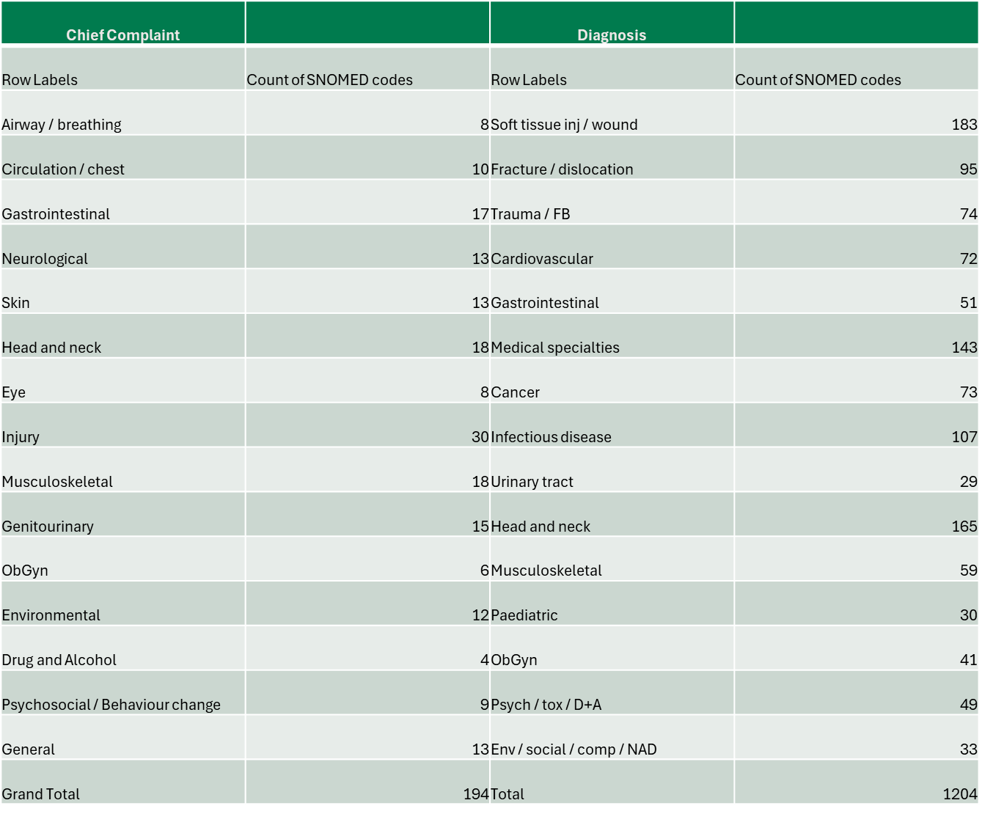
Sampling: Chief Complaint and Diagnosis variables
We would like to understand the barriers that Trusts faced in collecting the information for the Chief Complaint and Diagnosis variables from their systems and how you have dealt with long codes when submitting to ECDS.
Potential suggestions for work-arounds include:
  Map SNOMED codes to a short code: 1 = 10004674456, 2 = 1873941000000104, 3 = 813321000000103 etc
  Include a letter in front of the SNOMED code e.g. z10004674456 so when inserted into excel it reads as text. Feasibility to be discussed.
  Map Chief complaint and Diagnosis to the top-level of category ECDS_Group1 in the Enhanced Technical Output Specification (ETOS) V4.0.8 ECDS guidance and documents - NHS England Digital
  Any other suggestions?

Slide 13
Current priorities for UEC26

Slide 14
Current priorities for UEC26 – Patient pathways
We are currently exploring the pathways into UEC and support after leaving UEC services, reattendance and Same Day Emergency Care (SDEC) with stakeholders, however, we would also like to hear your views.
Patient pathways:
  The NHS 10-Year Plan aims to reduce avoidable A&E visits by improving access to care, expanding community services, and using digital tools. Survey data shows patients often face barriers like limited GP access or poor discharge communication. The plan supports self-referral and personalised care to improve outcomes and reduce reattendance.
We would like to understand from Trusts:
  Does this topic remain a priority for UEC26?
  Is understanding patient pathways as important / relevant for Type 3 services?
  Do current questions capture the level of detail needed to understand patients’ experiences before entering the emergency department (ED) or urgent treatment centres (UTC):
    Contact with other services before attending A&E (yes / no).
    Reasons for attending A&E.
    Places / services contacted before going to A&E (places listed e.g. pharmacist, GP practice etc).
    Main reason for attending A&E after contact with services.

Slide 15
Current priorities for UEC26 – Reattendance
Reattendance:
  NHS England’s 2025/26 plan targets avoidable reattendance by improving care quality and follow-up. While reattendance data is mainly collected for Type 1 A&E, 2024 results showed 20% of Type 3 patients also returned to UTCs and similar services. This highlights the need for broader system-wide improvements.
We would like to understand from Trusts:
  Does this topic remain a priority for UEC26?
  How is reattendance data used?
  Is understanding reattendance at a UTC as important as understanding reattendance at A&E?

Slide 16
Current priorities for UEC26 – Same-day Emergency Care(SDEC)
SDEC:
  Same Day Emergency Care (SDEC) is now a key part of urgent care in England, offering same-day treatment without admission. Despite being a priority, considerations such as local variation and whether SDEC patients would require a separate survey, remain.
Considerations:
  SDEC has consistently been identified as a priority area in previous surveys. The 2024 UEC scoping project examined the evolving landscape of urgent and emergency care services. Trusts indicated the current questionnaire doesn’t fully suit the SDEC pathway and that a new questionnaire may be required.
  Type 5 attendances are also not currently included in the Type 1 and Type 3 samples. Capturing this group would require an additional sample which may not be feasible for some Trusts.
We would like to understand from Trusts:
  Is SDEC still considered a priority for inclusion in the UEC survey?
  Would it be feasible to include Type 5 samples for all Trusts, using the current Type 1 questionnaire, or would a new questionnaire be needed?
  What impact would adding SDEC have on the current questionnaire, and what value would it bring?
  Are there any existing topics in the survey that could be deprioritised to accommodate SDEC?

Slide 17
Questionnaire feedback

Slide 18
Feedback on the UEC24 Questionnaire (1)
The Urgent and Emergency Care Survey seeks to understand patients’ experiences of using NHS UEC services among those aged 16 years or older. The current questionnaire (UEC24) covers topics outlined in the table below:
Pathway into urgent and emergency care services |  | Emotional support
Reattendance |  | Pain management
Duration of visit |  | Access to food and drinks
Ambulance handovers |  | Feeling safe
Waiting for first assessment (triage) |  | Confidence and trust
Care for condition while waiting |  | Tests
Involvement in care |  | Discharge, medications and information
Communication support needs |  | Care and support after leaving

Slide 19
Feedback on the UEC24 Questionnaire (2)
We would like to understand from Trusts whether these topics are still key priorities for the questionnaire or whether priorities have changed since 2024?
Are there any other questionnaire feedback Trusts have from UEC24?
  Any questions that have been particularly helpful in your action planning?
  Any questions that have not been useful/insightful?
Is there any data covered by the questionnaire that is already collected elsewhere?

Slide 20
Engagement

Slide 21



Boosting response rates
The Type 1 UEC24 survey saw a total of more than 35,000 completions, with a response rate of 28.8%. For the Type 3 survey in 2024, more than 10,000 people took part, with a response rate of 26.1%.
Response rates for the UEC survey are typically lower than other national patient surveys e.g. the 2024 Adult Inpatient Survey saw a response rate of 41% with more than 62,000 completions.
Increasing engagement: publicising the survey
Encourages patients to participate
Increased representation within the data
Increases cases for analysis
Further analysis of questions at Trust level
Sub-group analysis
Reduces the possibility of suppression
For further information:
https://nhssurveys.org/survey-instructions/publicising-surveys/

Slide 22
Boosting response rates – engagement materials (1)
Several materials are also available to help inform and advertise the survey to patients. These materials include:
  Press release template (prior to fieldwork) – highlights value of participating.
  Social media cards (prior to and during fieldwork) – promotes the survey.
  Website banner (during fieldwork) – promotes the survey.
We would like to understand how useful these materials are for you and whether you would like to see any further engagement activities or materials provided to boost patient response rates:
  Which of these materials did you use? e.g. press release template, social media cards, website banners.
  What platforms did you share these materials on? e.g. Trust websites, social media etc.
    Why did you choose these platforms?
  Are there any other formats or materials perhaps used on other Trust surveys that are effective in boosting engagement? e.g. short animated videos
  How do you think these materials could be improved?
    If you didn’t use the engagement materials in 2024, what prevented you from doing so?

Slide 23
Boosting response rates – engagement materials (2)
We would like to understand how useful these materials are for you and whether you would like to see any further engagement activities or materials provided to boost patient response rates:
  Which channels do you think are best to advertise the UEC survey?
    Social media, Trust websites, in your local Trust (e.g. waiting rooms, reception, wards), in a GP practice, in discharge packages, in local pharmacies, via email?
    Are there any apps or websites that patients regularly use e.g. online booking services, digital health services, that the survey could be promoted on?
  Messaging:
    What kind of information would be key to include on the engagement materials to communicate about the survey and encourage participation?
    Focus groups often show that patients are motivated by specific factors to participate:
      The impact and benefits of the survey on changes in services – what happens to the data, why should they take part?
      Is the survey from a credible source? e.g. NHS, CQC.
      How long will the survey take? Long surveys are typically not well-received unless incentivised.
      Is the survey relevant to their experiences?

Slide 24
Key dates

Slide 25
Key dates
  More detailed timelines will be made available in the 2026 UEC Survey Handbook for NHS Trusts managing sampling in-house and for those using an approved contractor.
  The survey handbook will be available for download from the NHS patient surveys website from the beginning of February 2026.
Activity | Date
Focus groups (frontline staff, patients); Stakeholder consultations | September 2025 – October 2025
Advisory group | 4th November 2025
Cognitive testing | Thursday 4th December 2025 – Tuesday 24th February 2026
Trust webinar 2 | Thursday 12th February 2026
Dissent posters published (English and translated) | Monday 17th November 2025
Section 251 (approval) | Friday 30th January 2026
Publication of sampling materials (survey handbook, sampling instructions, sample construction spreadsheet, sample declaration forms) (following section 251 approval) | Monday 2nd February 2026
Publication of patient facing materials (following section 251 approval) | 16th February 2026
Samples drawn by trusts | Monday 2nd March 2026 – Friday 27th March 2026
Submit sample to contractor | TBC by contractors
Submit sample to SCC [for trusts delivering survey in-house only] | Monday 30th March 2026
Sample checking (SCC) | Monday 23rd March 2026 – Friday 17th April 2026
Fieldwork (15 weeks) | Monday 13th April 2026 – Friday 24th July 2026

Slide 26
Any other points for discussion?

Slide 27
  If you have any further thoughts or queries, please contact us at emergency@surveycoordination.com

